Slide 1
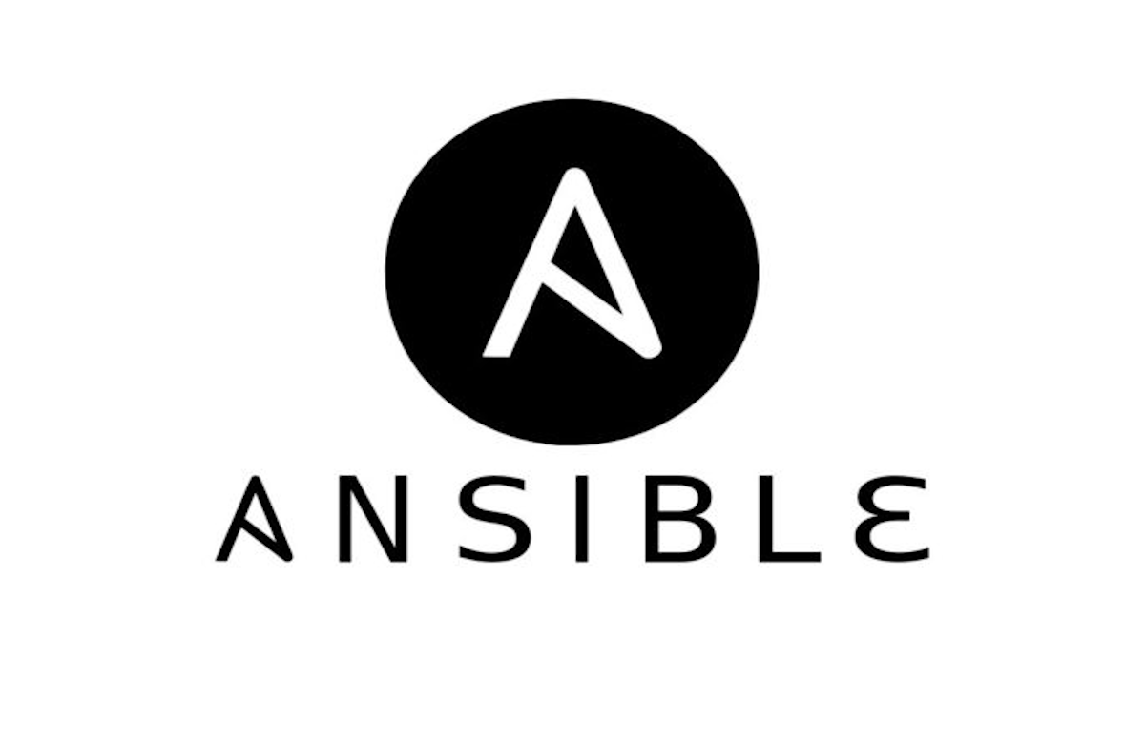
Ansible

Slide 2

What is Ansible ?
Open-source automation tool used for IT tasks such as configuration management, application deployment, orchestration, and task automation.
Maintained by Red Hat.
Notes:
Simplifies the management of IT infrastructure, reduces the workload of IT teams, and enables automation of complex IT processes.

Slide 3
Why is
Ansible ?

Slide 4


Simple and Easy to Learn:
Uses a simple syntax called "YAML," making it easy for beginners to learn and use.
It doesn't require any programming language knowledge
Agentless:
It doesn't need any software or agent to be installed on the managed hosts, simplifying the installation process and reducing the management overhead.
Doesn't require any agent installation on the remote hosts.
Notes:
Ansible is a popular automation tool for managing IT infrastructure and applications for several reasons:

Slide 5


Powerful and Flexible:
Inventory can accommodate various types of hosts, including cloud, and physical servers.
It also has a vast library of pre-built modules that enable automation of various IT tasks, making it a versatile tool for managing infrastructure.
Scalability:
Designed to support automation of large and complex IT environments.
It allows you to manage thousands of servers at once, enabling the automation of repetitive and time-consuming tasks.

Slide 6
Integration:
Integrates with various IT tools and technologies, such as cloud providers, container platforms, and orchestration tools.
This integration enables users to automate complex IT processes that involve multiple tools and technologies.
Community:
Has a large and active community that continuously contributes to the tool, creating a vast library of pre-built modules and supporting users in troubleshooting issues.

Slide 7
What is Ansible used for ?
Ansible for DevOps
Managing Docker containers
Utilizing for automation
Configuration management
Installing web application
Notes:
Adapting and scaling in response to demand. Benefits of Ansible in DevOps: the feedback loop is accelerated quicker, installations are dependable, IT architecture is coordinated, and deployments are faster.

Slide 8

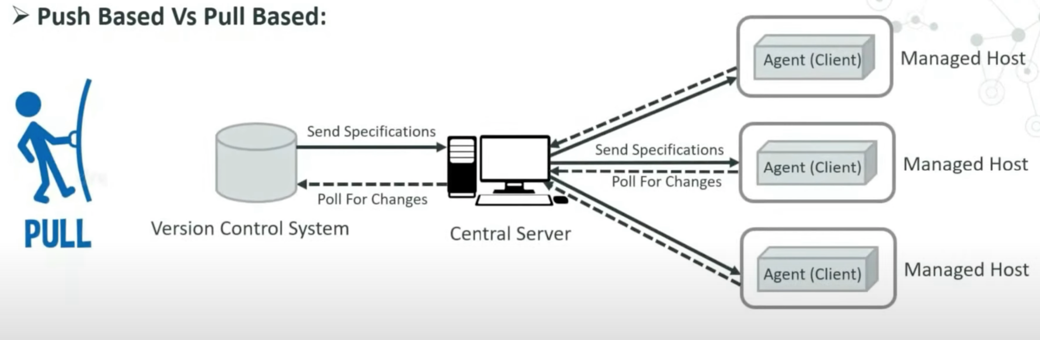
PULL vs PUSH BASED ARCHITECTURE
Tools like chef and puppet are pull architecture based
Agents on the the nodes periodically checks for configuration information from Central Server.
Notes:
Version control system manages all the changes in the codebase of the application
The central server constantly checks for any changes in vcs and if any changes those specifications are sent to the main server and
Then according to the changes new configuration are written and the agents then checks for config information and if found any then it pulls those changes and then only the info gets affected in the client machines

Slide 9
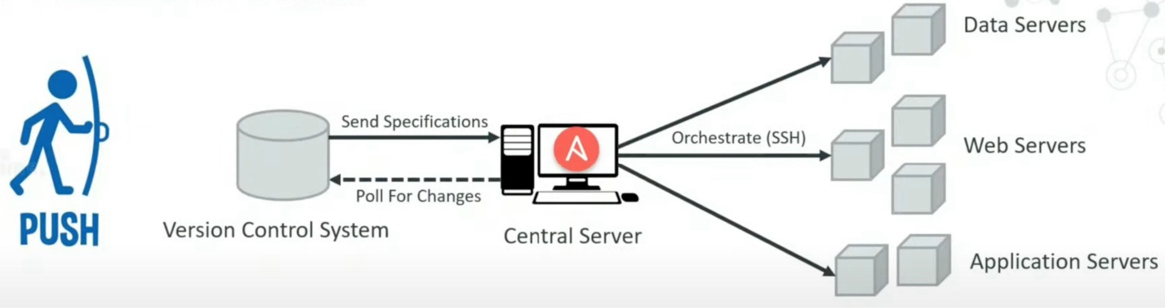
PUSH Architecture
Ansible has push based architecture and doesn’t need any agents running on the client nodes.
Central Server pushes the configuration information to the nodes.
Notes:
In the main server which is the central server is where the ansible tool is installed
Nodes are connected to main server via ssh
The central server constantly checks for any changes in vcs and if any changes those specifications are sent to the main server and
Then according to the changes new configuration are written and directly pushed to the clients
Drawbacks of pull - agent 30 mins - dependent

Slide 10
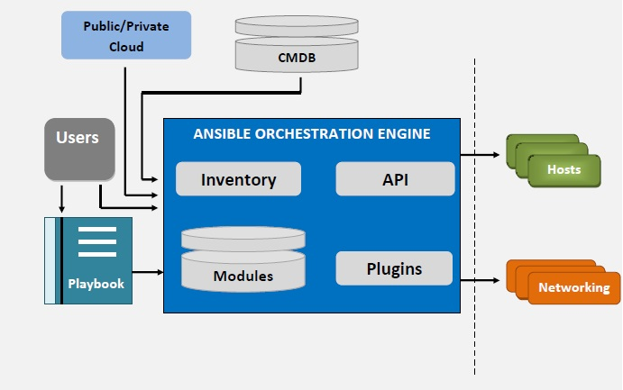
Ansible Architecture

Slide 11
Inventory
The inventory comprises all the nodes or hosts that need to be taken care of, along with their IP addresses, server details, databases, and other information.
All machines used with Ansible are listed in a single, easy-to-read file containing this comprehensive data.
After registering the inventory, you can assign parameters to multiple hosts using a simple text-based format.

Slide 12
Application Program Interface
One may use application programming interfaces or APIs to enhance Ansible’s connection choices.
This covers more than just using SSH for transmission and extends to callbacks and other functionalities.

Slide 13
Hosts and Networking
In the Ansible architecture, hosts are the nodal structures that Ansible manages, as well as any computer (RedHat, Linux, Windows, etc.).
It leverages a data model unique to the Ansible automation engines and can traverse multiple hardware platforms without any difficulties.

Slide 14
Cloud
A private or public cloud is a collection of distant servers that one may use to collect, organize, and process information.
Rather than keeping data on a local server, these systems are hosted over the internet.
It simply deploys the cloud resources and instances, links them to the databases, and you’re ready to handle your job remotely.

Slide 15
Configuration management database
A CMDB is a database serving as a data repository for IT systems.
By deploying the Ansible-CMDB code, users may automatically transform the results of Ansible’s data-collecting function into a static HTML summary page

Slide 16
Modules
Modules are essential software that Ansible delivers from the command computer to all nodal network points or distant hosts. They are predetermined instructions that are executed directly on remote hosts. Playbooks run modules that manage applications, packages, and files. Ansible executes all modules for delivering updates or performing the required activity and then eliminates them after they’re through. Ansible has over 450 modules for typical tasks. Ansible has hundreds of built-in modules, the pieces of code that are run when a playbook is launched. A playbook has plays, containing various tasks that include modules.

Slide 17
Playbooks
Playbooks for Ansible are task-specific user guides. Playbooks dictate your workflow since functions written in them are executed in the order they are written. They are simple text documents created in YAML, a data serialization language that humans understand. They are at the heart of what makes Ansible so attractive since they describe the tasks one must perform quickly without requiring the user to remember particular terminology. In addition to being able to describe settings, they may also orchestrate the stages of any manually arranged task and conduct tasks concurrently or sequentially.

Slide 18
Plugins
Plugins are little pieces of code that augment a website’s functionality. Ansible comes with several of these, but one can create their own.
Plugins are a specific type of module in this case. Before a module is performed on the nodes, the plugins are run.

Slide 19
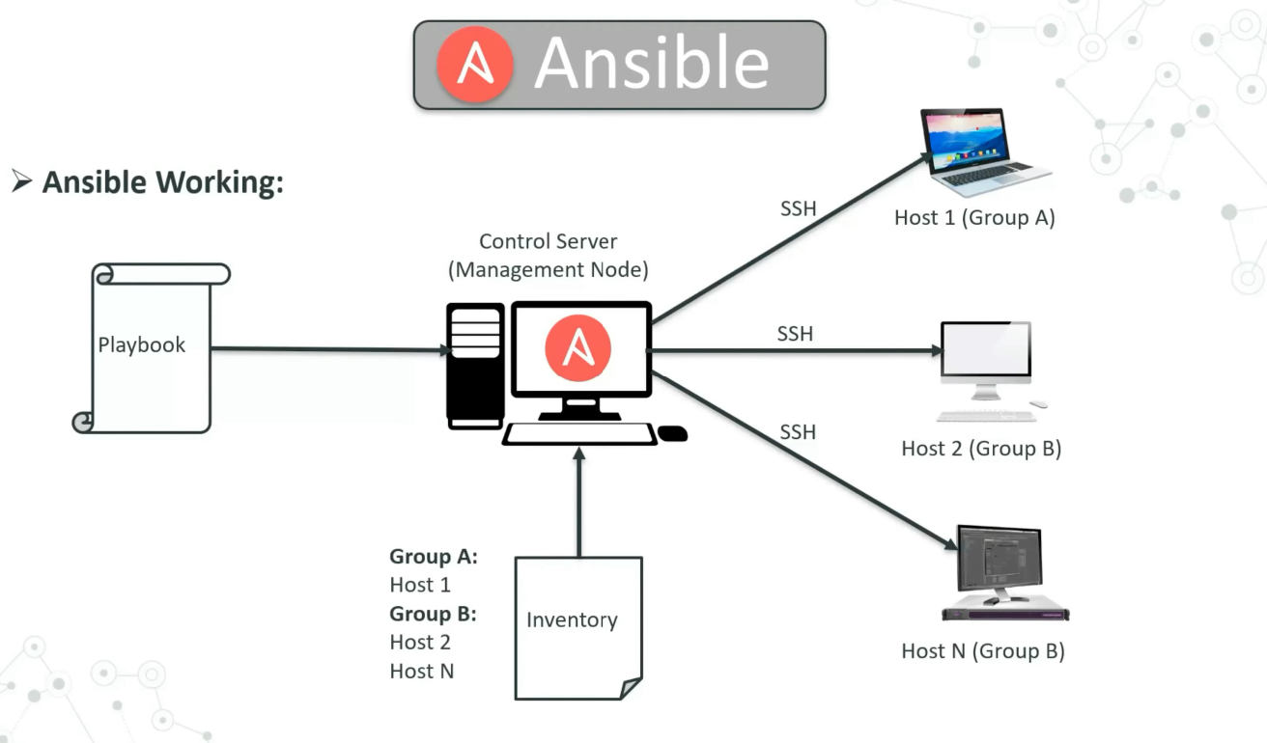
Notes:
Ansible works by connecting your nodes and pushing small programs called ansible modules to them and executes these modules over ssh by default and removes them when finished - The modules can reside in any machine
Management node controls the entire execution of the playbook
The inventory file provides list of host where the ansible module must be run

Slide 20
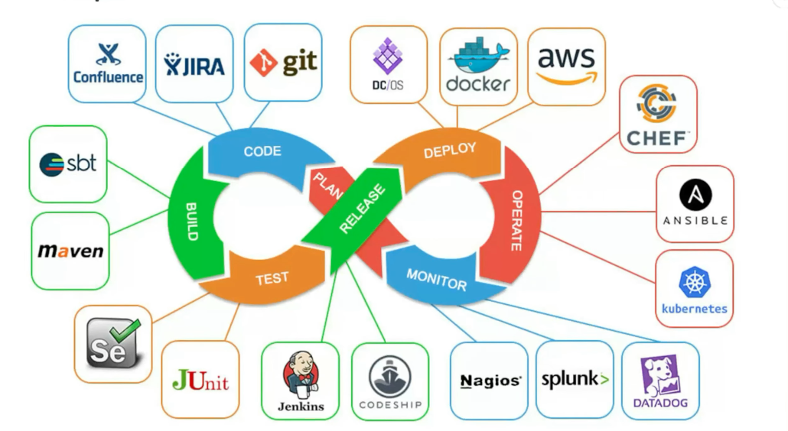
Ansible in Devops:
Notes:
In devops as we all know development and operations are integrated and ansible integrates this by providing a stable environment to both development and operations which results in smooth orchestration

